Slide 1

Centre for Project Management
Welcomes you to
Post Graduate in Advanced Project Management
Batch 33 – PG-APM

Slide 2
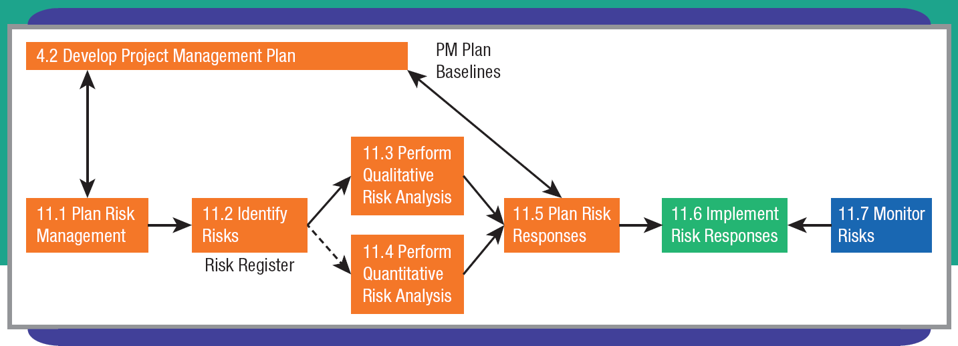
Project Risk Management

Slide 3

Project Risk Planning
Approach to risk is same on any project:
  Identify
  Assess
  Respond
Level of depth/energy expended on risk planning varies greatly among projects
Purpose of risk management is to reduce overall project risk to acceptable level (NOT to avoid risk entirely)
More detailed risk management in iteration planning, daily stand-up meetings, retrospectives

Slide 4
Plan Risk Management (1 of 2)
A P M must understand success measures & priorities for a project in order to develop a risk management plan
Risk management plan decides details to approach, plan, & execute risk management activities
Plan risk management – “the process of defining how to conduct risk management activities for a project.” ~Practice Standard for Project Risk Management (P M I)

Slide 5
Plan Risk Management (2 of 2)
What constitutes project success?
  Meeting various agreements (i.e., contracts)
  Did project meet customers’ expectations?
  Did project help the performing organization?
    New technologies
    Employee growth
EXHIBIT 11.1: PROJECT SUCCESS MEASURES
Meeting Agreements
Cost, schedule, and specifications met
Customer’s Success
Needs met, deliverables used, customer satisfied
Performing Organization’s Success
Market share, new products, new technology
Project Team’s Success
Loyalty, development, satisfaction
Source: Kloppenborg, Timothy J., Debbie Tesch, and Broderick King, “21st Century Project Success Measures: Evolution, Interpretation, and Direction,” Proceedings, Project Management Institute Research and Education Conference, July 2012, Limerick, Ireland.

Slide 6
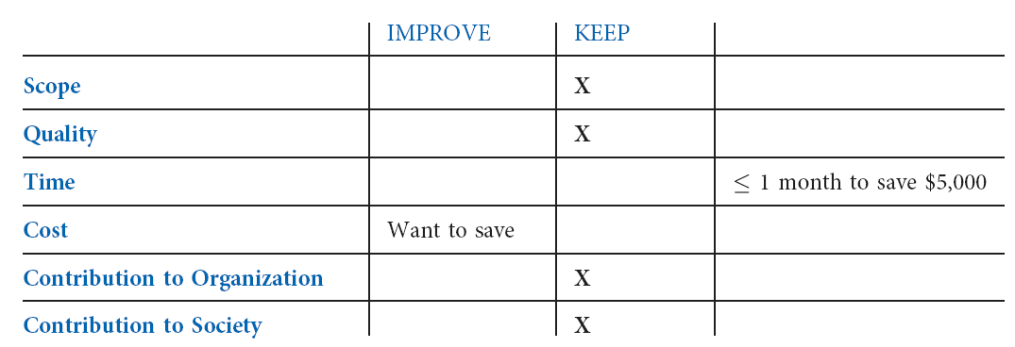
Specific Project Stakeholder Priorities
EXHIBIT 11.2: SPECIFIC PROJECT STAKEHOLDER PRIORITIES
Source: Adapted from Timothy J. Kloppenborg and Joseph A. Petrick, Managing Project Quality (Vienna, VA: Management Concepts, Inc., 2002), 46.

Slide 7
Risk Management Planning & Stakeholder Priorities
Understand what the project plan calls for
Understand area the most important stakeholders like to improve
Understand where stakeholders are willing to sacrifice to enable improvements

Slide 8
Understanding the Project Risk (1 of 2)
EXHIBIT 11.3: RISK MANAGEMENT PLAN GUIDANCE FOR AN IT CONSULTING COMPANY
Risk management includes guidance on how to perform three risk management activities:
Decide what level of risk premium to charge for the project. The team must rate factors such as project size, complexity, technology, and type. The combined ratings dictate that a risk premium of 0, 10, or 20 percent be added to the estimated project cost or, for very risky projects, that executive approval is mandated.
Mitigate risk external to the firm through contract clauses and risk internal to the firm through agreements.
Manage the risk very carefully through specifically designed weekly conference call meetings and reports.
Source: Rachana Thariani, P M P®

Slide 9
Understanding the Project Risk (2 of 2)
project risk – anything that may impact the project team’s ability to achieve the general project success measures and the specific project stakeholders’ priorities
threat – “a risk that will have a negative impact on the project objective if it occurs.” ~Practice Standard for Project Risk Management (P M I)
opportunity – “a risk that would have a positive effect on one or more project objectives.” ~Practice Standard for Project Risk Management (P M I)

Slide 10
Plan Risk Management
Roles & Responsibilities
Categories & Definitions
Risk management plan– part of the project management plan that describes how risk management activities will be prioritized, monitored, planned & performed; also used for communicating with project stakeholders & for follow-up analysis

Slide 11
Roles and Responsibilities
Encourage wide participation in risk management activities
More perspectives considered → more risks uncovered
Participation encourages buy-in to a risk management approach
Identify who is responsible for each risk

Slide 12
Categories and Definitions (1 of 2)
More project risks generally uncovered early in the life of a project
The cost per risk discovered early is less
Risks discovered late in a project can be expensive
Categorizing risks often leads to more thorough risk identification. Classify by:
  Stage of project lifecycle
  Project objective that would be impacted
  External versus internal to project
  What is known versus unknown (uncertainty)

Slide 13
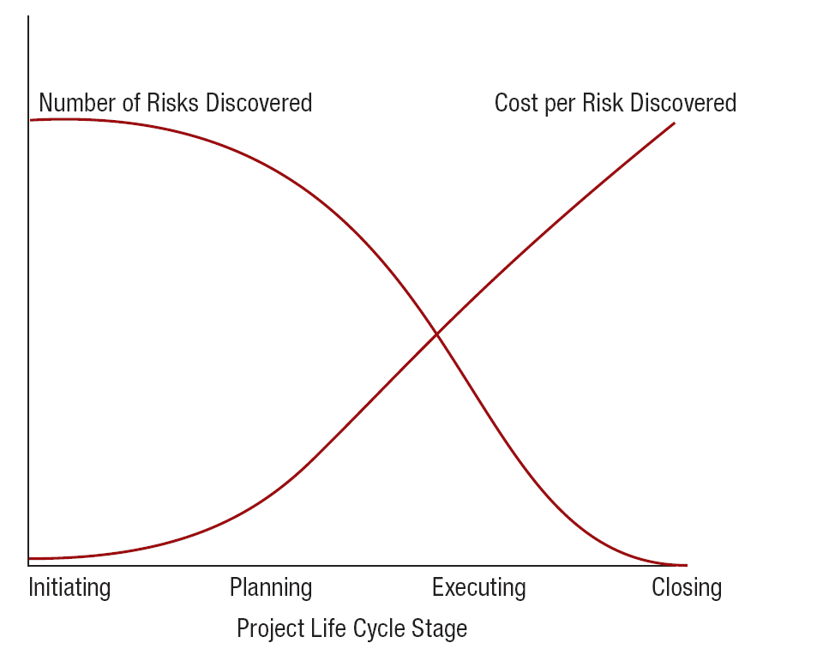
Risks Over the Project Life Cycle
EXHIBIT 11.4: RISKS OVER THE PROJECT LIFE CYCLE

Slide 14
Categories and Definitions (2 of 2)
Cement will harden
Bad weather will happen
100-year flood
A “known known” can be planned and managed with certainty
“Known unknowns” can be identified and may or may not happen
“Unknown unknowns” are true uncertainties

Slide 15
International Construction Project Risk Factors
EXHIBIT 11.5: FOURTEEN MOST IMPORTANT RISKS IN PANAMA CANAL EXPANSION
Changes in design and quantities | Extreme bad weather
General inflation | Inadequate claims administration
Ineffective contracting process | Inefficient planning
Insufficient revenues | Lack of controls
Lack of skilled and local labor | Local labor strikes
Material, equipment, and labor cost | Organizational risks
Owner-driven changes | Referendum delays
Source: Alarcon, Luis F., et al., “Risk Planning and Management for the Panama Canal Expansion Program,” Journal of Construction Engineering and Management (October 2011): 762–770.

Slide 16
Top Risks for International Projects
EXHIBIT 11.6: TOP RISKS IN EACH FACTOR FOR INTERNATONAL PROJECTS
CULTURAL | VIRTUAL
Number of languages | Communication issues
Trust level | Number of countries
Economic culture | Management experience
Number of religions | Number of time zones
POLITICAL | REGIONAL
Government desire for project | Crime rate
Government unrest | Climate/weather
Laws and regulations | Housing availability
Relationship with government | Safety issues and procedures
Source: Steffey, Robert W., and Vittal S. Anantatmula, "International Projects Proposal Analysis: Risk Assessment Using Radial Maps," Project Management Journal (April 2011): 62-70.

Slide 17
Top Risks for Software Projects
EXHIBIT 11.7: TOP RISKS IN EACH FACTOR FOR SOFTWARE PROJECTS
EXECUTION MANAGEMENT | USER COORDINATION
Configuration management system | User evaluation of progress
Formality of status reports | User understanding of complexity
Specification approval process | Care in user manual preparation
Post-project audits | Coordination with user
Regularity of technical reviews | Informal communication channels
HUMAN RESOURCE MANAGEMENT | PROJECT PLANNING
Flexibility of working hours | Frequency of software reuse
Individual performance incentives | Planning tools used
Technical assistance availability | Minimum cost software design
Recognition for extra work | Removal of unnecessary requirements
Enforced attendance system | Individual accountability
Source: Thomas, Sam, and M. Bhasi, “A Structural Model for Software Project Risk Management,” Journal of Management (March 2011): 71–84.

Slide 18
Identify Risks
Information gathering
Reviews
Understanding Relationships
Risk register
Identify risks – “the process of determining which risks might affect the project and documenting their characteristics.” ~Practice Standard for Project Risk Management (P M I)

Slide 19
Information Gathering (1 of 2)
Brainstorming activity considering “what could go wrong”
Variations & extensions of possible risks can help to identify additional risks
Interview stakeholders
S W O T analysis, Delphi technique

Slide 20
Information Gathering (2 of 2)
S W O T analysis – detailed analysis of project’s strengths, weaknesses, opportunities, & threats
Delphi technique– an info gathering technique whose goal is to reach consensus among a group of experts; involves soliciting anonymous expert opinions, summarizing them, & sending them back to the experts for further comments and improvements

Slide 21
Structured Reviews
Reviewing documents developed for the project & for other uses helps i.d. risks
TYPE OF REVIEW | QUESTION
Charter | Is there clarity and common understanding in each section?
Stakeholder register | What could upset any of them?
Communication plan | Where could poor communications cause trouble?
Assumptions | Can you verify that each assumption is correct?
Constraints | How does each constraint make the project more difficult?
W B S | What risks can you find going through the W B S item by item?
Schedule | What milestones and other merge points might be troublesome?
Resource demands | At what points are certain people overloaded?
Touch points | What difficulties may arise when some project work is handed off from one person to another?
Literature | What problems and opportunities have been published concerning similar projects?
Previous projects | What projects and opportunities have similar projects in your own organization experienced?
Peers | Can your peers identify any additional risks?
Senior management | Can senior management identify any additional risks?
EXHIBIT 11.8: PROJECT RISK REVIEWS

Slide 22
Understanding Relationships (1 of 2)
Use a flow chart to learn the cause-and-effect relationships of risk events
Consider why a certain risk event may happen through root cause analysis
Root cause analysis – an analytical technique to ascertain the fundamental or causal reason(s) that affect one or more variances, defects, or risks.

Slide 23
Understanding Relationships (2 of 2)
Understand trigger conditions
A trigger may be specific to an individual risk
Trigger condition – “a circumstance under which a risk strategy or risk action will be invoked.” ~Practice Standard for Project Risk Management (P M I)

Slide 24
Risk Register
Primary output of risk identification…see Exhibit 11.9 in text
Risk register – “the document containing the results of the qualitative risk analysis, quantitative risk analysis, and risk response planning. It identifies all identified risks, including description, category, cause, probability of occurring, impact(s) on objectives, proposed responses, owners, and current status.” ~Practice Standard for Project Risk Management (P M I)
Identified risks
Risk categories
Potential causes
Potential responses

Slide 25
Risk Analysis
Understanding enough about each risk to determine how fully & formally it will be handled
  Perform Qualitative Risk Analysis
  Perform Quantitative Risk Analysis
  Risk Register Updates

Slide 26
Perform qualitative Risk Analysis
How likely is this risk to happen?
How big will the impact be?
Qualitative risk analysis performed on all projects
Perform qualitative risk analysis – “the process of prioritizing risks for further analysis or action by assessing and combining their probability of occurrence and impact.” ~Practice Standard for Project Risk Management (P M I)

Slide 27
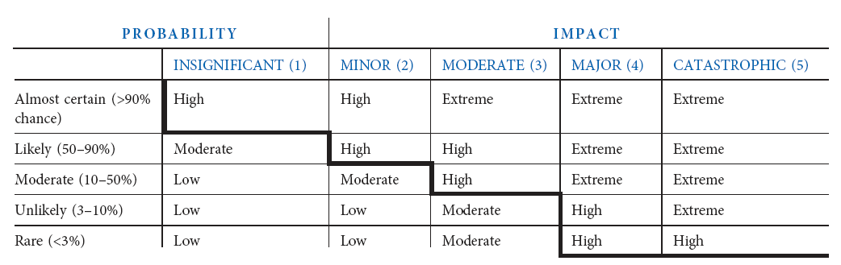
Qualitative Risk Assessment
Differentiate between major & minor risks using probability, impact, & P M judgment…each major risk needs a contingency plan and single “owner”
EXHIBIT 11.10: QUALITATIVE RISK ASSESSMENT

Slide 28
Qualitative Risk Analysis
Cause and effect relationships
  One way to assess magnitude of effect is to understand cause
  Part of root cause analysis
  Change the effect by changing the underlying cause
  Use a cause and effect diagram

Slide 29
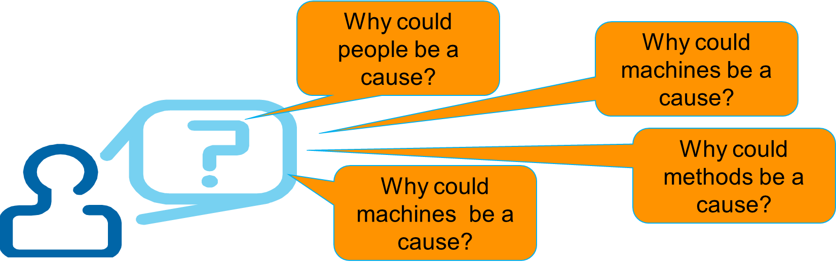
Cause and Effect Diagram
List the risk as the effect in a box at head of the fish
Name the big “bones”
Complete the smaller “bones”

Slide 30
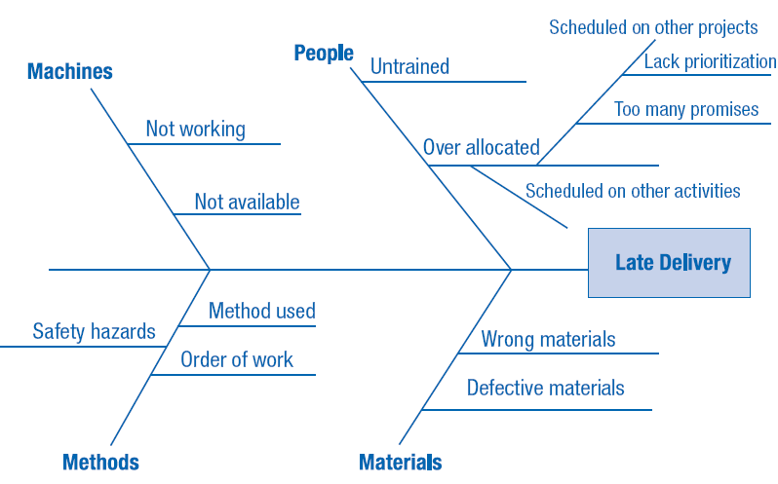
Cause and Effect Diagram

Slide 31
Perform Quantitative Risk Analysis
Bigger, riskier, more complex, more expensive projects → quantitative structured techniques
Use to predict the probabilities
ON-TIME
ON-BUDGET
SCOPE
QUALITY
Quantitative risk analysis – “the process of numerically analyzing the effect of identified risks on overall project objectives.” ~Practice Standard for Project Risk Management (P M I)

Slide 32
Common Quantitative Risk Analysis Techniques (1 of 2)
Decision tree analysis | A graphic tool depicting alternative choices as branches, multiple options for each alternative, & evaluating potential outcomes in terms of uncertainty and monetary value
Expected monetary value (E V A) analysis | A statistical technique to calculate present value of future outcomes to choose the best alternative
Failure mode and effect analysis (F M E A) | “A step by step approach for identifying all possible failures in a design, a manufacturing or assembly process, or a product or service.” ~Practice Standard for Project Risk Management (P M I)

Slide 33
Common Quantitative Risk Analysis Techniques (2 of 2)
Sensitivity analysis | A quantitative what-if risk analysis technique that presents comparative analyses of various desirable outcomes with respect to a financial measure or uncertainty…can be used to determine which risks have the most impact on the project outcomes or goals. i.e. Tornado diagram
Simulation | A technique that mimics real situations using uncertainties and assessing their impact on project objectives. i.e. Monte Carlo

Slide 34
Criteria for Selecting a Quantitative Risk Technique Methodology
Use the explicit knowledge of project team members
Allow quick response
Help determine project cost & schedule contingency
Help foster clear communication
Easy to use & understand

Slide 35
Risk Register Updates (1 of 2)
Add probability of each risk occurring & its impact to the register
Document results of quantitative risk analysis in risk register

Slide 36
Plan Risk Responses
Strategies for Responding to Risks
Risk Register Updates
Plan risk responses – “the process of developing options and actions to enhance opportunities and reduce threats to project objectives.” ~Practice Standard for Project Risk Management (P M I)

Slide 37
Strategies for responding to risks
STRATEGY | TYPE OF RISK | EXAMPLES
Avoid | Threat | 1. Change project plan and/or scope 2. Improve project communications 3. Decide not to perform project
Transfer | Threat | 1. Insurance 2. Fixed-price contract 3. Hire expert
Mitigate | Threat | 1. Lower probability and/or impact of threat 2. Build in redundancy 3. Use more reliable methods
Accept | Threat and opportunity | 1. Deal with it if and when it happens 2. Establish triggers and update frequently 3. Establish time and/or cost contingencies
Research | Threat and opportunity | 1. Get more and/or better information 2. Verify assumptions 3. Use prototype
Exploit | Opportunity | 1. Assign talented resources to project 2. Give more emphasis to project
Share | Opportunity | 1. Allocate partial ownership to third party 2. Form joint venture
Enhance | Opportunity | 1. Increase probability and/or positive impact 2. Identify and maximize key drivers 3. Add more resources
Many projects use multiple strategies depending on combo of risks faced (p. 375 in textbook)
EXHIBIT 11.12: COMMON PROJECT RISK STRATEGIES
Source: Adapted from A Guide to the Project Management Body of Knowledge (P M B O K® Guide) (Newtown Square, PA: Project Management Institute, 2008): 261–263; Paul S. Royer, Project Risk Management: A Proactive Approach (Vienna, VA: Management Concepts, Inc., 2002): 35; and Eric Verzuh, The Fast Forward M B A in Project Management, 2nd ed. (Hoboken, NJ: John Wiley & Sons, 2005): 100–103.

Slide 38
Risk Register Updates (2 of 2)
Keep register updated with results from risk response planning
Include any changes to the project schedule, budget, resource assignments & communications plan

Slide 39
Summary (1 of 2)
All projects have some risks
Risk planning should use an appropriate level of detail to plan for major risks
Risk planning begins with an understanding of project success
Risk management plan is part of the overall project management plan
Risk identification includes gathering information on potential risks

